Slide 1
Common framework

Slide 2
Common Framework on Public Health Protection and Health Security - Origin
As an EU Member State, the UK was bound to comply with EU law. Subsequently, in many nominally developed policy areas, the institutional and legal frameworks underpinning the operation of the EU ensured a near consistent set of rules and regulations across the UK.
During a UK Government common frameworks exercise held in August 2017, health protection and health security was identified as one area of considerable intra-UK coordination that was, in part, underpinned by our relationship with the EU and its associated agencies.
A programme of work was established between the UK Government and Devolved Governments to agree post-EU transition common UK-wide approaches in these areas, both through legislative and non-legislative means. As part of the UK Government programme, frameworks are required to pass through five programme phases.
Establishing principles and proof of concept of all common frameworks
Policy Development
Review, consultation and more detailed policy development
Preparation and implementation
Post implementation arrangements
This was a review and assessment stage where the framework was tested with key stakeholders and assessed against other frameworks to ensure alignment and consistency. The framework progressed on 11th November 2020 to the next stage and a provisional framework was approved by the Joint Ministerial Committee for EU Negotiations (JMC(EN)).
The allowed for the development of drafting instructions and outlines. These required approval from UKG and Devolved Governments’ portfolio ministers.
This stage allows formal consultation of stakeholders where necessary, including UK Parliament, and allows time for any implementation steps to be taken. At the end of this stage the JMC(EN) will formally sign off the framework.
This was completed by the joint UK Government and Devolved Governments project team between October 2017 and March 2018.
Ongoing review and assessment of the framework. This phase will also include developing the agreed work programme.

Slide 3
Common Framework on Public Health Protection and Health Security – Policy area and definitions
The Framework takes an “all hazards” approach to health protection and health security, including threats arising from infectious disease and non-infectious threats, such as radiation, chemical and environmental hazards.
This is in line with existing national policies and the International Health Regulations (IHR) (2005).
Definitions for the key terms in this policy area are as follows:
‘Public Health Protection’ means protecting individuals, groups and populations from infectious disease and non-infectious public health threats including radiation, chemical and environmental hazards.
‘Health Security’ means the activities required, both proactive and reactive, to minimise vulnerability to acute public health events that endanger the collective health of populations living across geographical regions and international boundaries.
‘Serious cross-border threat to health’ means a life-threatening or otherwise serious hazard to health of biological, chemical, environmental or unknown origin which spreads or entails a significant risk of spreading across the borders of at least one Member State and the United Kingdom, or may necessitate a coordinated response by the UK authorities in order to ensure a high level of human health protection. This definition includes events that may constitute public health emergencies of international concern under the IHR and is aligned with the definition of serious cross-border threat to health agreed between the UK and the EU for the purposes of the UK-EU Trade and Cooperation Agreement (TCA).

Slide 4
Common Framework on Public Health Protection and Health Security - Overview
Following discussions between UKG, Devolved Administrations and the UK public health agencies of England, Wales, Scotland and Northern Ireland on the goal of this work, and the most appropriate vehicles for implementing it, it has been decided that both legislative and non-legislative mechanisms are necessary to underpin the framework.
The Health Security (EU Exit) Regulations 2021 came into force on 1 September 2021. The Regulations establish a standalone regime which will ensure all parts of the UK continue to coordinate on data sharing, epidemiological surveillance, and their approach to the prevention and control of serious cross-border threats to health. The Regulations also support the implementation of the UK’s arrangements with the EU for cooperation on health security under TCA in exercise of the powers conferred by section 31 of the European Union (Future Relationship) Act 2020.
There will also be a non-legislative agreement, by way of a Memorandum of Understanding (MoU) between administrations to strengthen cooperation on public health protection and health security. The MoU will include:
Communication and coordination of health protection activities, including policy development, public campaigns and messaging and expert committees
Principles for coordinated use of mutual aid
International engagement
Workforce
Education and Training
Research
Data and Intelligence
The framework’s operation will be underpinned by a work programme, which will be agreed by the UK Health Protection Committee (and developed by the Four Nations Health Protection Oversight Group). It will be aligned with, and complementary to, the Health Security (EU Exit) Regulations 2021.

Slide 5
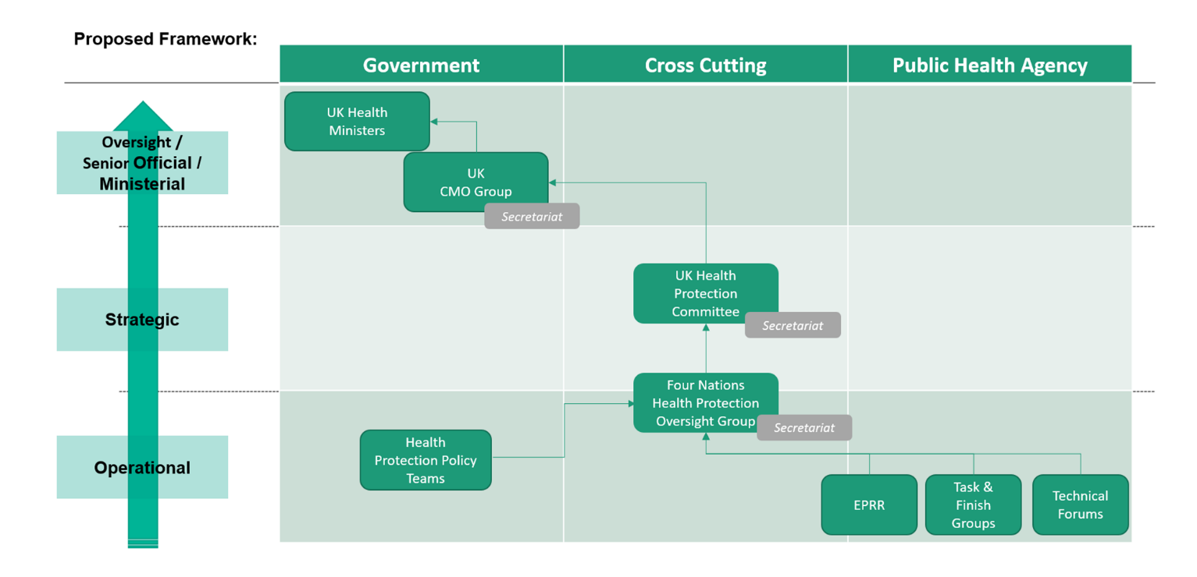
Common Framework on Public Health Protection and Health Security - Governance
The Framework formalises the existing UK Health Protection Oversight Group, which will be responsible for its implementation, including by developing the underpinning work programme.
The Framework, through the Health Security (EU Exit) Regulations 2021, also establishes the UK Health Protection Committee. The UK Health Protection Committee will support and monitor the application of the Framework, as well as be responsible for a number of functions in the proposed Health Security (EU Exit) Regulations 2021, for example UK-wide surveillance of communicable diseases and related special health matters.
Notes:
.

